Slide 1
Android Botnet Detection Using Machine Learning
Vidyavardhini’s College of Engineering & Technology
K.T. Marg, Vartak College Campus, Vasai Rd, Vasai-Virar, Maharashtra 401202
Department of Artificial Intelligence and Data Science
Yash Patil (18)
Chetan Sapkal (37)
Shubhamkar Patra(35)
Project Guide: Mrs. Sneha Yadav
Date: 28/04/2023

Slide 2
Contents
Abstract
Introduction
Problem Definition
Proposed approach / System Design
Implementation / Methodology
Results & Discussion
Conclusion
References

Slide 3
Abstract
A botnet is widely spreading malware among mobile application.
Android botnets are networks of compromised devices used to spread malicious software and execute malicious activities.
It’s mainly aim to hack the entire system and abduct the details of the user.
Machine Learning is a powerful tool for detecting these threats and protecting users from harm.

Slide 4
What is Botnet ?
A Botnet is a network of compromised computers under the control of a remote hacker.
Controller of a botnet is able to direct the activities of these compromised computers.
Botnet Terminology
Bot Herder(Bot Master)
Bot
Bot Client
IRC Server
Command and Control Channel(C&C)

Slide 5
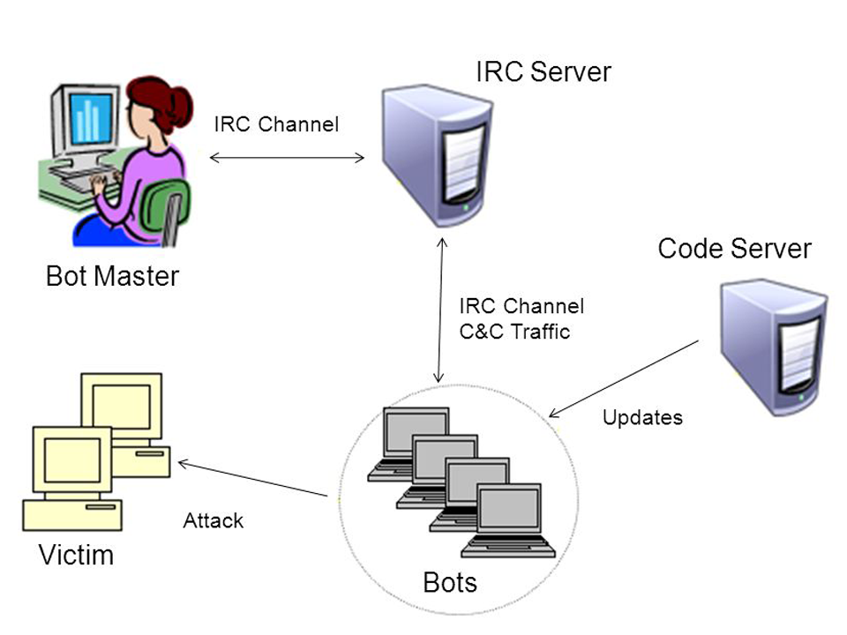
Botnet(Terminology)

Slide 6
Problem Definition
Bots are stealthy on the infected machines.
Bot infection is usually a multi-faceted and multi-phased process.
Bots are dynamically evolving.

Slide 7
Proposed approach / System Design
Using Machine Learning for Android botnet detection, It’s offers several benefits.
It’s has ability to detect new types of botnets across different devices.
These algorithms can identify patterns in network traffic that indicate malicious activity.

Slide 8
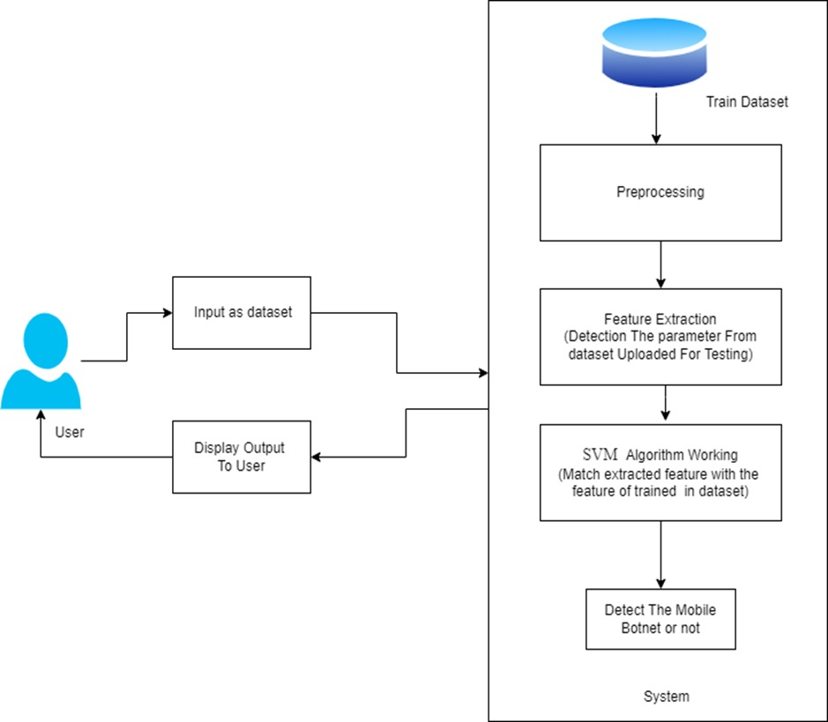

Slide 9
Implementation / Methodology
The feature extraction methodology is used with the support vector machine to detect botnet-infected apps.
ISCX dataset is used to test the botnet applications.
The dataset contain botnet infected-apps and our proposed methodology is used to detect it.

Slide 10
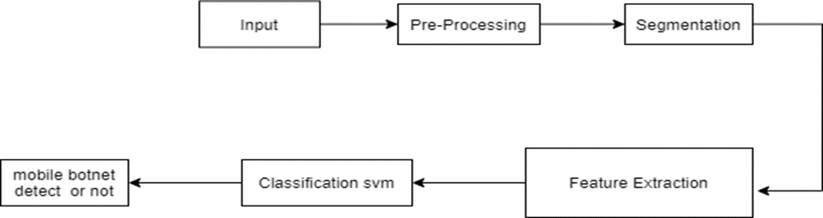
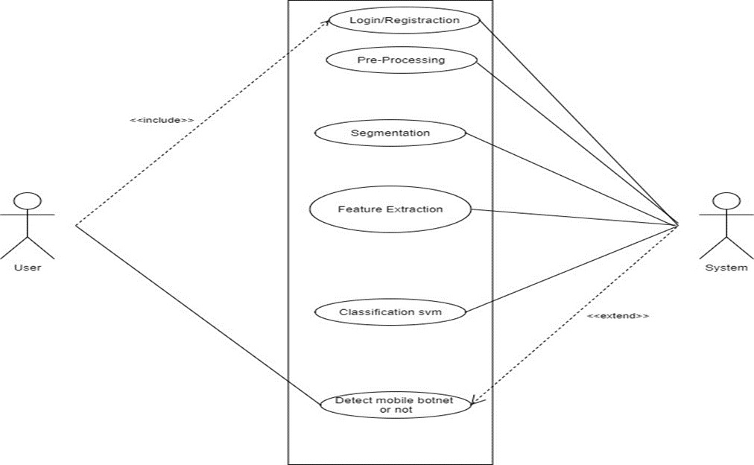
Working

Slide 11
Results & Discussion
Testing on the predefined datasets got the conclusion of successfully testing against the dataset on 342 static app features to distinguish between botnet apps and normal apps.

Slide 12
Conclusion
In summary, the widespread use of botnets for spreading malware among mobile applications poses a significant threat to user privacy and security. However, the use of machine learning algorithms offers an effective solution for detecting and protecting against these threats. The proposed system uses a feature extraction methodology and support vector machines to identify botnet-infected apps across different devices. The results show that the system can successfully detect and prevent botnet attacks, making it an essential tool for mobile app security.

Slide 13
References
1. McAfee Mobile Threat Report Q1. 2020. Available online: https://www.mcafee.com/en-us/consumer-support/2020 mobile threat report.html (accessed on 5 December 2020).
2. Yerima, S.Y.; Khan, S. Longitudinal Performance Analysis of Machine Learning based Android Malware Detectors. In Proceedings of the 2019 International Conference on Cyber Security and Protection of Digital Services (Cyber Security), Oxford, UK,3–4 June 2019.
3. Grill, B.B.; Ruthven, M.; Zhao, X. “Detecting and Eliminating Chamois, a Fraud Botnet on Android” Android Developers Blog. March 2017. Available online: https://androiddevelopers.googleblog.com/2017/03/detecting-and-eliminating-chamois-fraud. html (accessed on 10 December 2020).
4. Chris Brook “Google Eliminates Android Adfraud Botnet Chamois” Threat Post. March 2017. Available online: https://threatpost.com/google-eliminates-android-adfraud-botnet-chamois/124311/ (accessed on 10 December 2020).

Slide 14
5. W. T. Strayer, D. Lapsley, R. Walsh, and C. Livadas, “Botnet detection based on network behavior,” Advances in Information Security, vol. 36, pp. 1–24, 2019.
6. L. Atzori, A. Iera, and G. Morabito, “The internet of things: a survey,” Computer Networks, vol. 54, no. 15, pp. 2787–2805, 2020.
7. M. Feily, A. Shahrestani, and S. Ramadass, “A survey of botnet and botnet detection,” in Proceedings of the 3rd International Conference on Emerging Security Information, Systems and Technologies (SECURWARE ’09), pp. 268–273, June 2021.

Slide 15
Thank You!

